Slide 1
Unit V–Optical Link Power Budget Analysis

Slide 2

Point-to-Point Links
The simplest transmission link is a point to point link that has transmitter on one end and a receiver on the other end.
LED or laser
MMF or SMF
pin or APD
(a) Emission wavelength
(b) Spectral line width
(c) Output power
(d) Effective radiating area
(e) Emission pattern
(a) Core size
(b) Core index profile
(c) BW or dispersion
(d) Attenuation
(e) NA or MFD
(a) Responsivity
(b) Operating λ
(c) Speed
(d) Sensitivity
Fig. Simplex Point to Point Link
The cost and performance are very important factors in fiber optic communication links
These types of links are used at a less demand on optical fiber technology. The designer carefully chooses the components to give a desired performance over the expected lifetime.

Slide 3
Key system requirements needed to analyze optical fiber links:
1. The desired (or possible) transmission distance
2. The data rate or channel bandwidth
3. The desired bit-error rate (BER)

Slide 4
To fulfill these requirements the designer has a choice of the following components and their associated characteristics:
2. LED or laser diode optical source
(a) Emission wavelength
(b) Spectral line width
(c) Output power
(d) Effective radiating area
(e) Emission pattern
(f) Number of emitting modes
1. Multimode or single-mode optical fiber
(a) Core size
(b) Core refractive-index profile
(c) Bandwidth or dispersion
(d) Attenuation
(e) Numerical aperture or mode-field diameter
3. pin or avalanche photodiode
(a) Responsivity (~quantum efficiency)
(b) Operating wavelength
(c) Speed
(d) Sensitivity

Slide 5
System Considerations
1. Wavelength of operation:
In carrying out a link power budget, we first decide at which wavelength to transmit and then choose components operating in this region.
If the distance over which the data are to be transmitted is not too far, we may decide to operate in the 800 - 900-nm region.
On the other hand, if the transmission distance is relatively long, we may want to take advantage of the lower attenuation and dispersion that occurs at wavelengths around 1300 or 1550 nm.

Slide 6
System Considerations
2. Source:
The system parameters involved in deciding between the use of an LED and a laser diode are signal dispersion, data rate, transmission distance, and cost.
The spectral width of laser output is much narrower than that of an LED.
Since laser diodes typically couple from 10 to 15 dB more optical into a fiber than an LED, greater repeater less transmission distances are possible with a laser.
This advantage and the lower dispersion capability of laser diodes may be offset by cost constraints.
Not only is a laser diode itself is expensive than an LED, but also the laser transmitter circuitry is much complex.

Slide 7
System Considerations
3. Photo Detector:
In choosing a particular photodetector, we mainly need to determine the minimum optical power that must fall on the photodetector to satisfy the bit error rate (BER) requirement at the specified data rate.
A pin photodiode receiver is simpler, more stable with changes in temperature, and less expensive than an avalanche photodiode receiver.
In addition, pin photodiode bias voltages are normally less than 50 V, whereas those of avalanche photodiodes are several hundred volts.
However, the advantages of pin photodiodes may be overruled by the increased sensitivity of the avalanche photodiode if very low optical power levels are to be detected.

Slide 8
System Considerations
4. Optical fiber:
For the optical fiber we have a choice between single-mode and multi-mode fiber, either of which could have a step- or a graded-index core.
This choice depends on the type of light source used and on the amount of dispersion that can be tolerated.
Light-emitting diodes (LEDs) tend to be used with multimode fibers (although special LEDs called edge-emitting LEDs can launch sufficient optical power into a single-mode fiber for transmission at data rates up to 560 Mb/s over several kilometers.
The optical power that can be coupled into a fiber from an LED depends on the core-cladding index difference Δ, which, in turn, is related to the numerical aperture of the fiber (for Δ = 0.01 the numerical aperture NA = 0.21).
As Δ increases, the fiber-coupled power increases correspondingly.

Slide 9
System Considerations
4. Optical fiber (cont.):
However, since dispersion also greater with increasing Δ, a tradeoff must be made between the optical power that can be launched into the fiber and the maximum tolerable dispersion.
Either a single-mode or a multimode fiber can be used with a laser diode A single-mode fiber can provide the ultimate bit-rate-distance product, with values of 30 (Gb/s).km being achievable.
A disadvantage of single-mode fibers is that the small core size (5 to 16 µm in diameter) makes fiber splicing more difficult and critical than for multimode fibers having 50 µm core diameters.

Slide 10
Design Considerations
Link Power Budget Analysis
Power margin calculations between the transmitter and receiver considering attenuation, connectors, splices and other losses.
Rise Time Budget
Rise time calculations and speed of response of system considering various dispersive effects.
These two budgets give necessary conditions for satisfactory operation

Slide 11
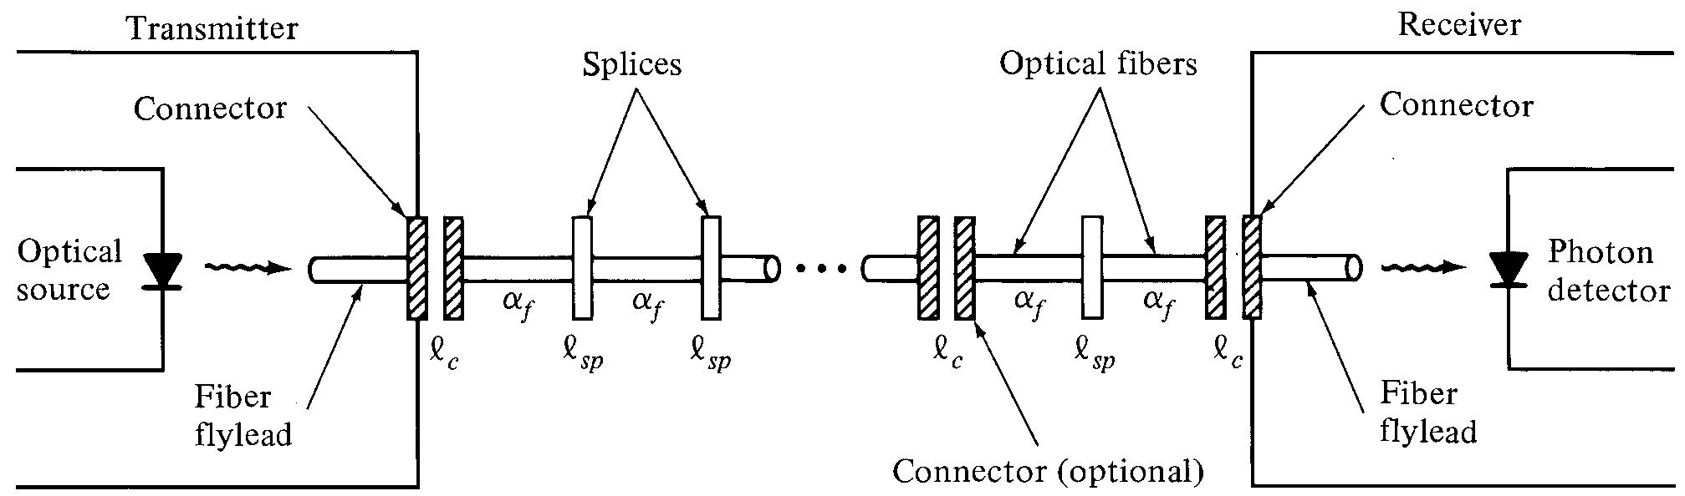
Optical power-loss model

Slide 12
Link Power Budget
The optical power received at the photodetector depends on,
The amount of light coupled into the fiber,
The losses occurring in the fiber, and
At the connectors and splices
Let l_{c} denotes the losses occur at the connector
l_{sp} denotes the losses at the splices, and
α_{f} denotes losses in the fiber
The link loss budget is derived from the sequential loss contributions of each element in the link. Each of these loss elements is expressed in decibels (dB) as,
Loss = 10 log (P_{out}/P_{in})
P_{in}- Optical power enter into the loss element,
P_{out} – Optical power output from the loss element

Slide 13
Link Power Budget
Link power margin considers the losses due to the component aging, temperature fluctuations and losses arising from the components
Usually a link margin of 6-8 dB is considered while estimating link power budget
The link power loss considers the total optical power loss P_{T} between the light source and photodetector. This loss is allocated to cable attenuation, connector loss, splice loss and system margin.
The total power loss (P_{T}) in the link is given by,
The total power loss = Optical power at light source – Optical power at receiver (or) Receiver sensitivity
P_{T}=P_{S}-P_{R}
Total optical power loss (P_{T}) = Connector loss + Splicing loss and fiber attenuation + System Margin
P_{T} = 2l_{c} + α_{f}L + P_{m}
Ps – Optical power emerging from the end of a fiber fly lead attached to the light source
P_{R} – Receiver sensitivity l_{c} – Connector loss α_{f} - Fiber attenuation in dB/km,
L – Transmission distance

Slide 14
Link Power Budget
Example:
Specifications: Data Rate 20 Mb/s, BER 10⁻⁹
Receiver: pin photodiode @ 850 nm → Required input signal = - 42 dBm
Optical source: GaAlAs LED with average optical power 50 µW = -13 dBm
Connector loss: 1 dB at both transmitter and receiver
System margin: 6 dB
Thus,
P_{T} = P_{S} – P_{R}
= 29 dB = 2(1 dB) + αL + 6 dB
αL = 21 dB
If α = 3.5 dB/km, then a 6-km transmission path is possible.

Slide 15
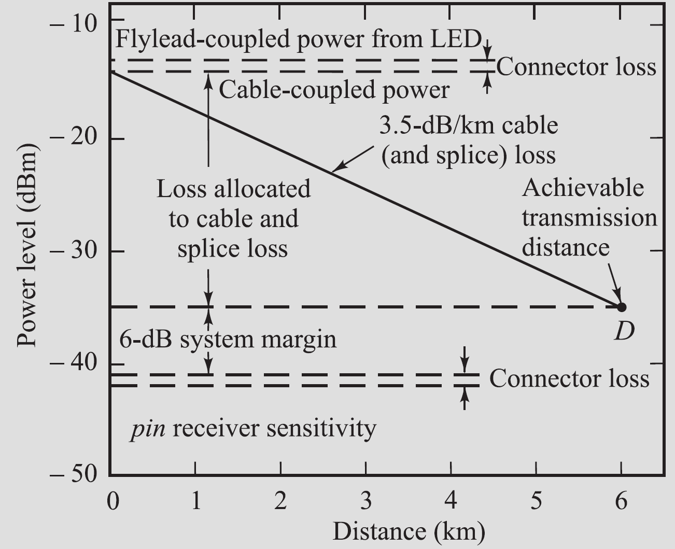
Link Power Budget
Graphical representation of a link loss budget for an 850-nm LED/pin system operating at 20 Mb/s.

Slide 16
Rise Time Budget
Rise time budget analysis determines the dispersion limitation of an optical fiber link
Total System Rise time (T_{sys}):
Here the total system rise time t_{sys} is the root sum square of the rise times from each contributor t_{i} to the pulse rise time degradation
Total rise time of a digital link should not exceed 70% for a NRZ bit period, and 35% of a RZ bit period

Slide 17
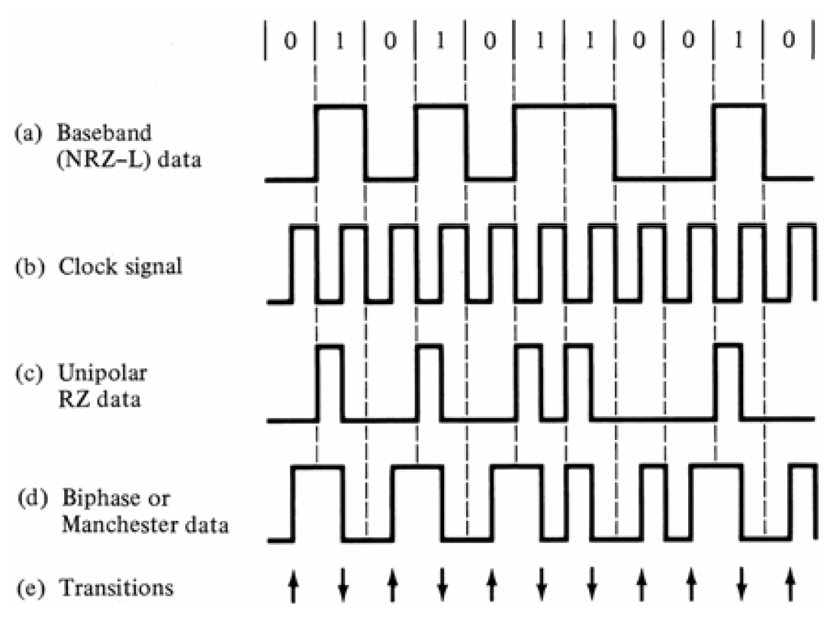
Two-level Binary Channel Codes

Slide 18
Rise Time Budget
The system speed is limited by,
Transmitter rise time r_{tx},
Model dispersion rise time (t_{mod}) of the fiber,
Group velocity dispersion (GVD) rise time t_{GVD} of the fiber, and
Receiver rise time t_{rx}
Hence, the total rise time t_{sys} becomes,
Since there is no model dispersion for SM fiber the rise time is related only to GVD.

Slide 19
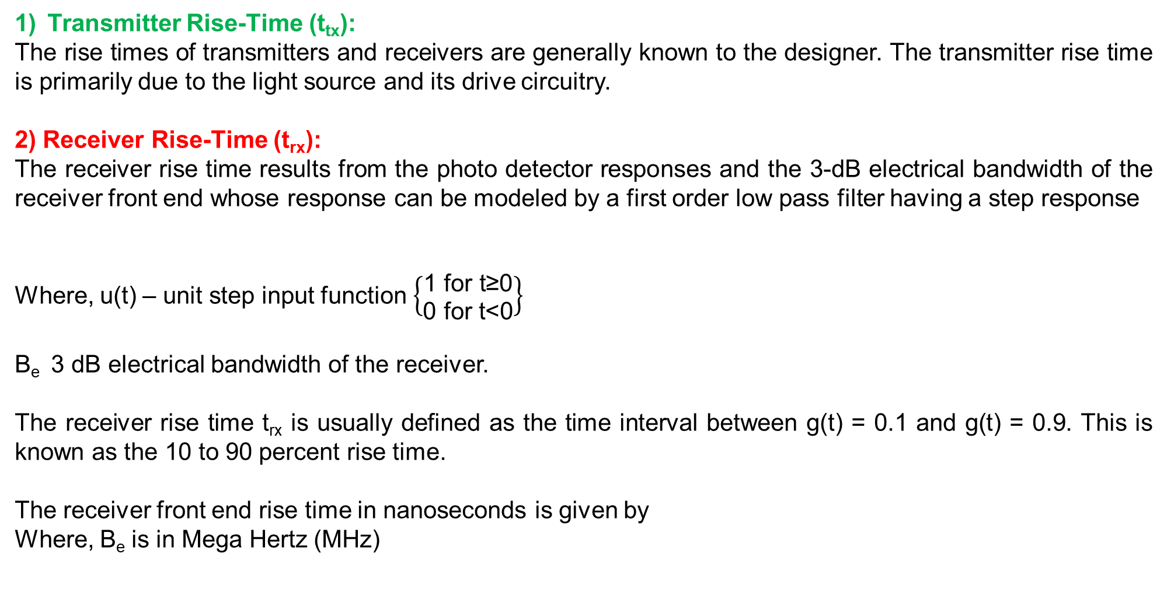
Rise Time Budget
Transmitter Rise-Time (t_{tx}):
The rise times of transmitters and receivers are generally known to the designer. The transmitter rise time is primarily due to the light source and its drive circuitry.
2) Receiver Rise-Time (t_{rx}):
The receiver rise time results from the photo detector responses and the 3-dB electrical bandwidth of the receiver front end whose response can be modeled by a first order low pass filter having a step response
Where, u(t) – unit step input function $\left\{\begin{aligned}\text{1 }\text{for} \text{t}\text{≥0} \\ \text{0 }\text{for} \text{t}\text{<0}\end{aligned}\right\}$
B_{e} 3 dB electrical bandwidth of the receiver.
The receiver rise time t_{rx} is usually defined as the time interval between g(t) = 0.1 and g(t) = 0.9. This is known as the 10 to 90 percent rise time.
The receiver front end rise time in nanoseconds is given by
Where, B_{e} is in Mega Hertz (MHz)

Slide 20
Rise Time Budget
3) Group velocity dispersion rise time (t_{GVD})
The group velocity dispersion rise time over a length L is given
Where, σ_{λ} Half spectral width of the source, and D Dispersion
To find the model dispersion rise time, bandwidth B_{M} in a link of length “L” can be expressed by empirical relation
Where, “q” is the parameter ranges between “0.5” and “1”, and
B₀ is the bandwidth of a 1 km length of cable

Slide 21
Rise Time Budget
At q=0.5, the steady stat model equilibrium has been reached and q=1 indicated little mode mixing. Based on the field experience, a reasonable estimate is q=0.7.
Based on the curve fitting of experimental data the bandwidth BM is given as
Where, Bn is the bandwidth of the n_{th} section.
The above equation can be written as
t_{M}(N) is the pulse broadening occurring over “N” cable sections, and
t_{n} is the individual pulse broadening.

Slide 22
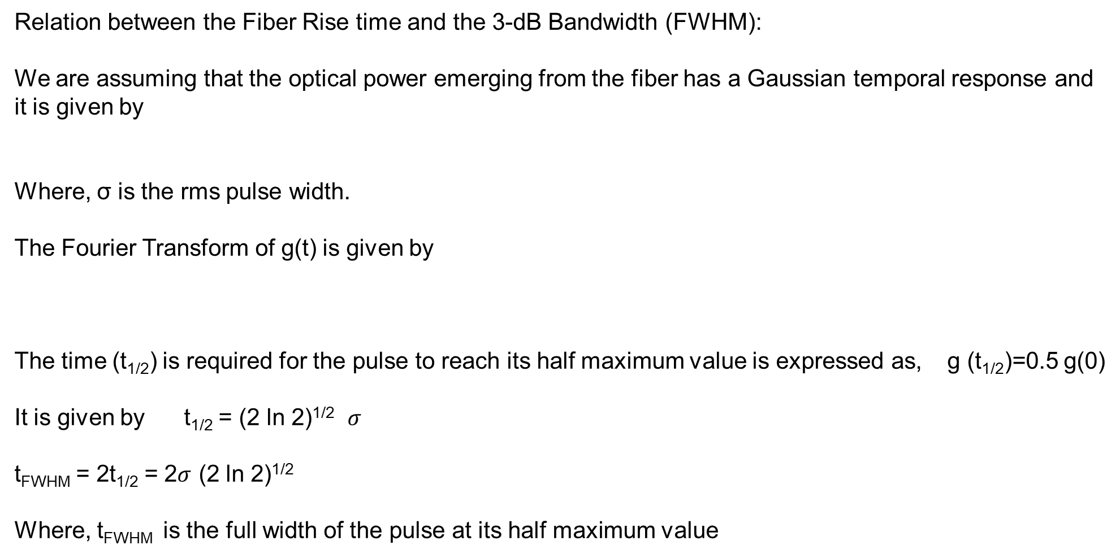
Relation between the Fiber Rise time and the 3-dB Bandwidth (FWHM):
We are assuming that the optical power emerging from the fiber has a Gaussian temporal response and it is given by
Where, σ is the rms pulse width.
The Fourier Transform of g(t) is given by
The time (t_{1/2}) is required for the pulse to reach its half maximum value is expressed as, g (t_{1/2})=0.5 g(0)
It is given by t_{1/2} = (2 ln 2)^{1/2} $σ$
t_{FWHM} = 2t_{1/2} = 2$σ$ (2 ln 2)^{1/2}
Where, t_{FWHM} is the full width of the pulse at its half maximum value

Slide 23
Relation between t_{FWHM} and 3-dB Optical Bandwidth:
The 3-dB optical bandwidth B_{3dB} is defined as, “the modulation frequency f_{3dB} at which the received optical power has fallen to 0.5 of the zero frequency value”.
If t_{FWHM} is the rise time resulting from model dispersion and it is given by,
If t_{mod} and BM are expressed in nanoseconds and MHz respectively, then

Slide 24
Total Rise Time
The total rise time t_{sys} is
Where all the times are given in nanoseconds,
σ_{λ} is the half power spectral width of the source, and
the dispersion D is in ns/(nm.km) and is 0.07 ns/(ns.km) in the 800-900 nm region.
This is due to the material dispersion for a dispersion shifted fiber and it is given by

Slide 25
Rise-time budget for a multimode link
Example:
Specifications: Data Rate 20 Mb/s, BER 10⁻⁹
LED : rise time 15 ns; spectral width 40 nm;
Fiber : material-dispersion related rise time 21 ns over 6 km link;
400 MHz·km bandwidth-distance product, q = 0.7 →t_{mod} =3.9 ns
Receiver : 25 MHz bandwidth → t_{rx} =14 ns
= 30 ns
For 20 Mb/s NRZ system, T_{b,NRZ} = 50 ns. Thus, t_{sys} < 0.7T_{b,NR}Z and the rise-time requirement is met.

Slide 26
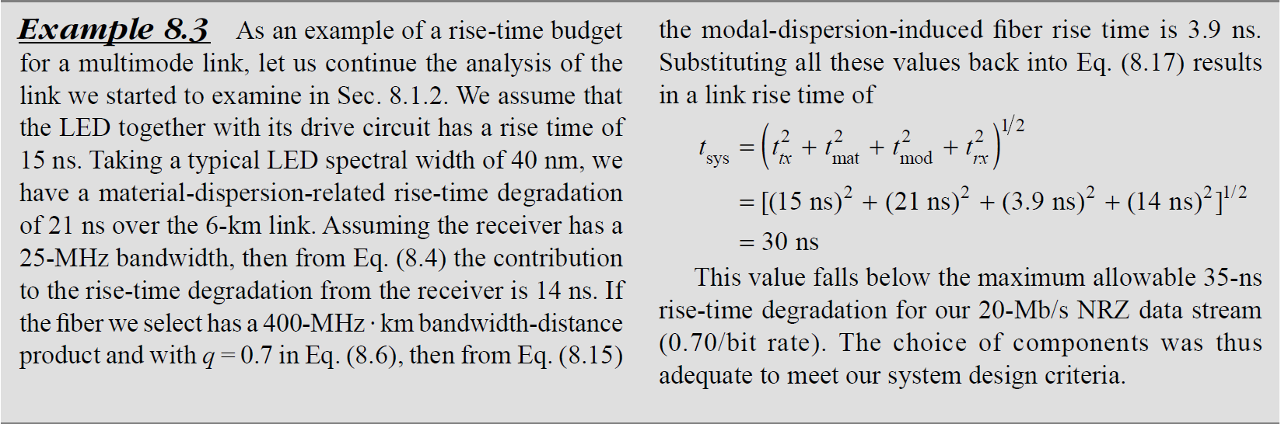

Slide 27
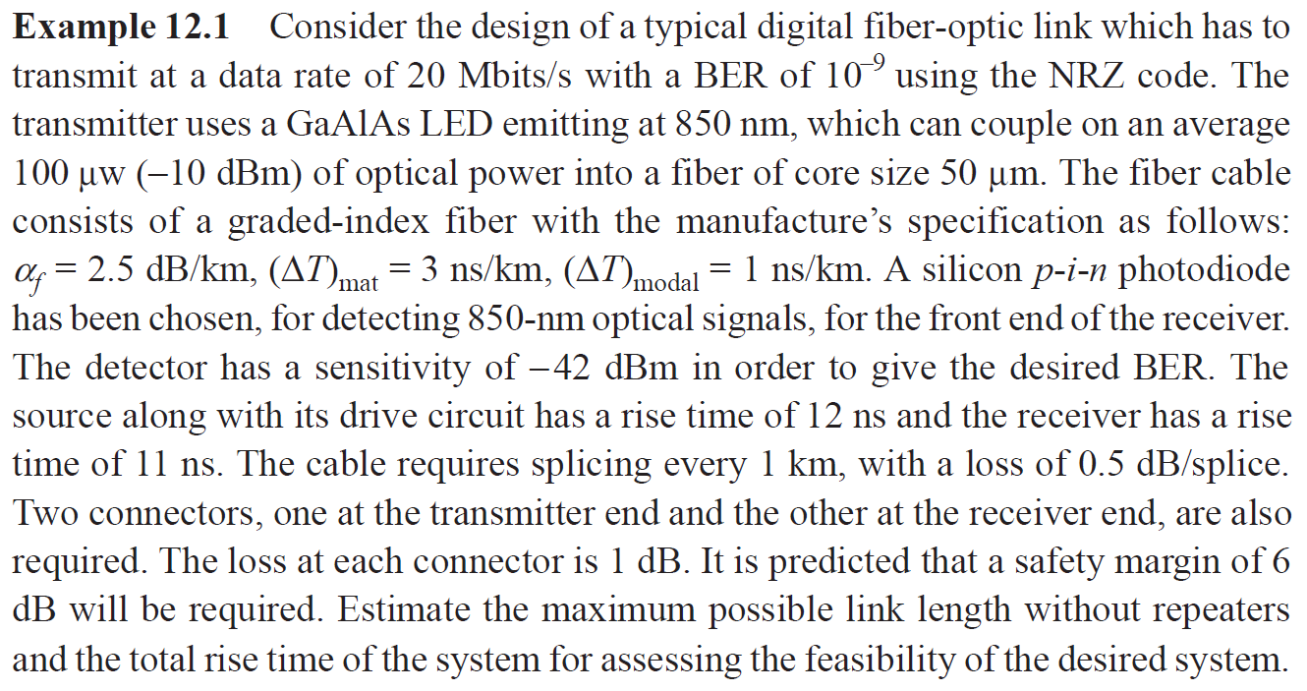

Slide 28
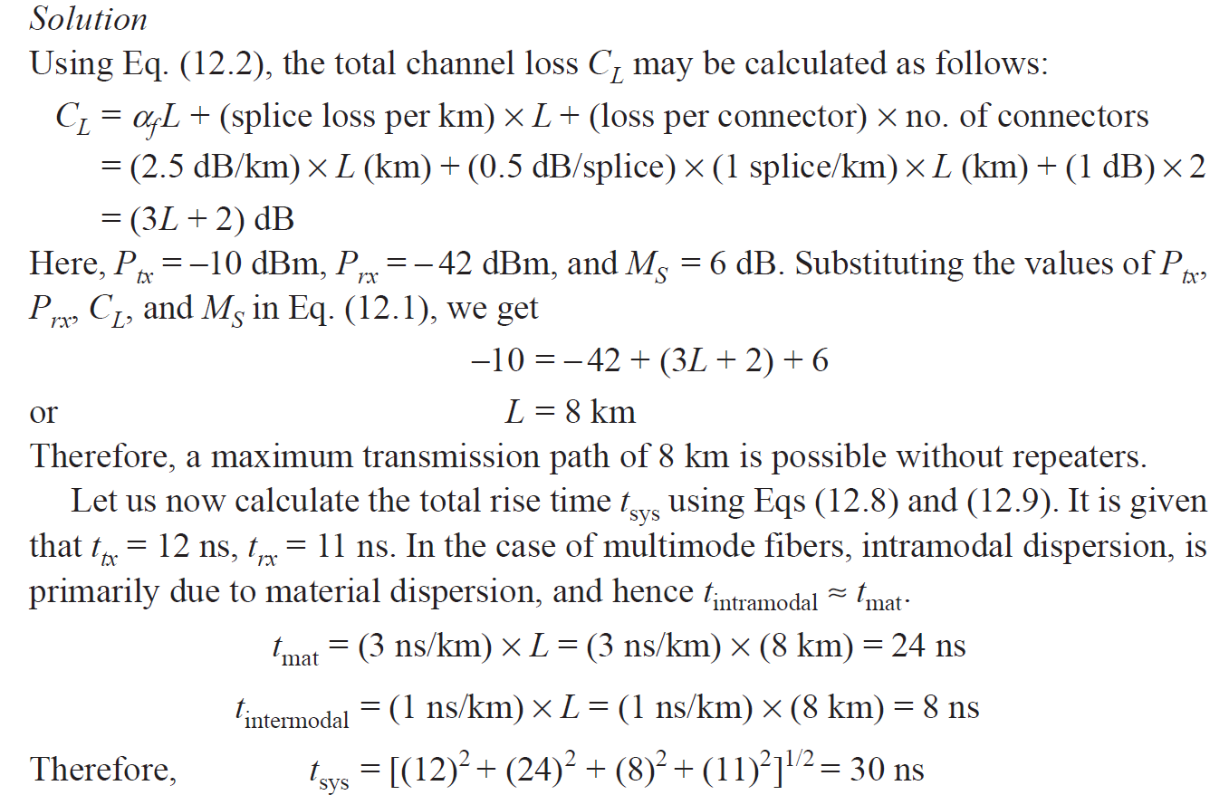

Slide 29
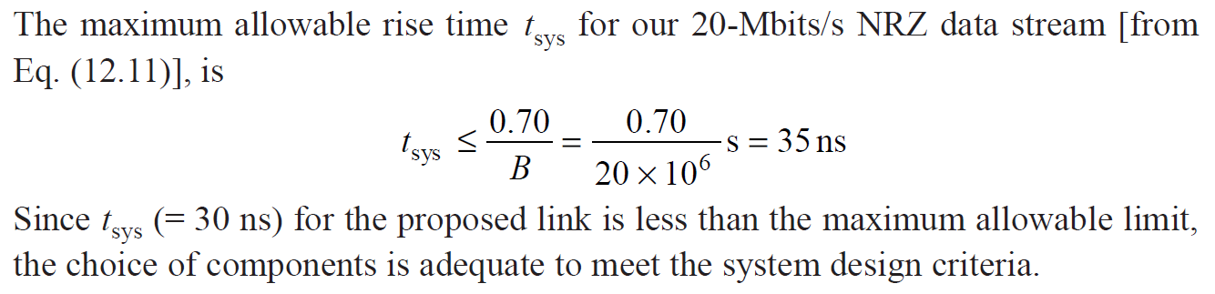

Slide 30
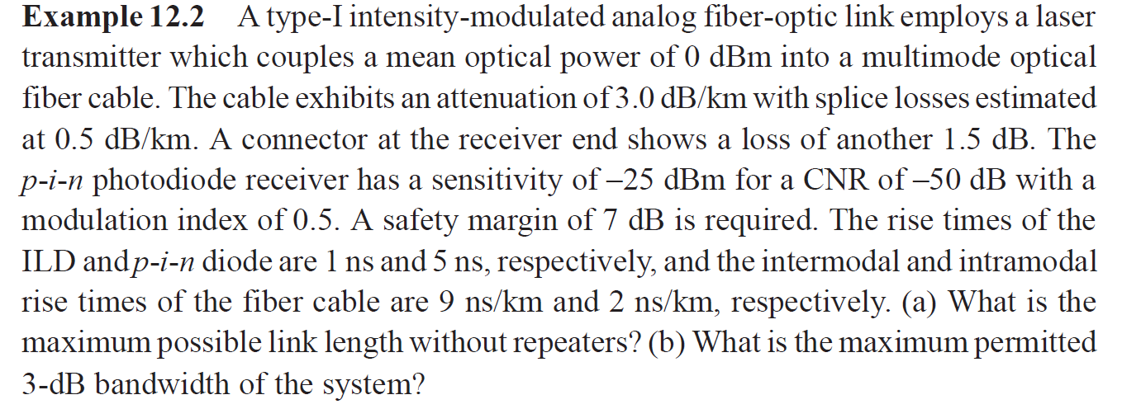

Slide 31
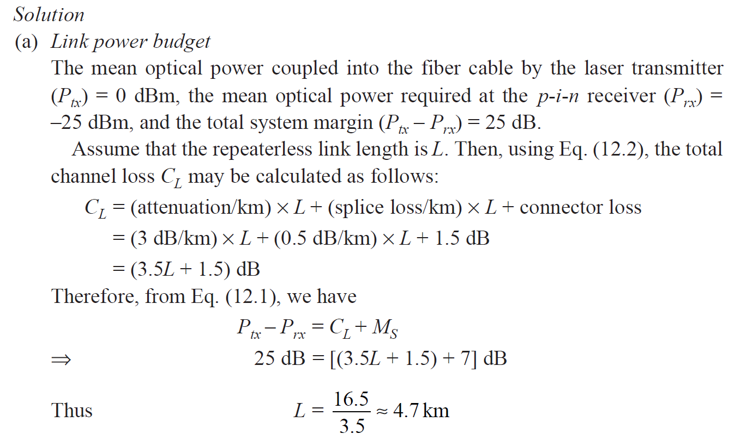

Slide 32
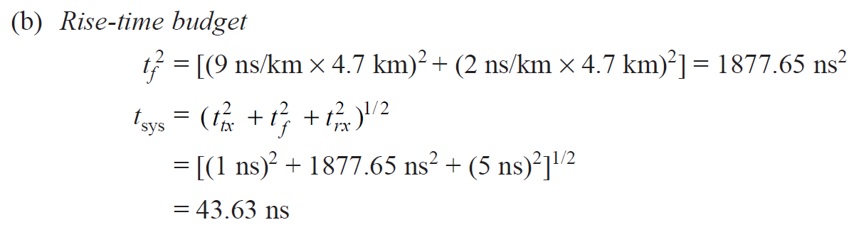
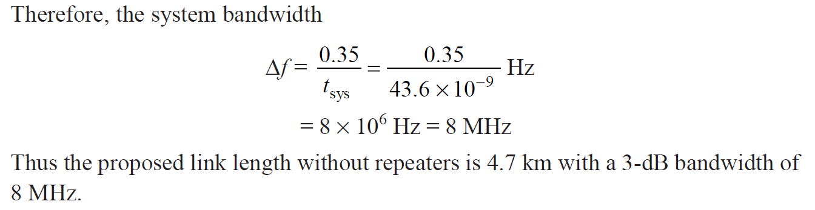

Slide 33
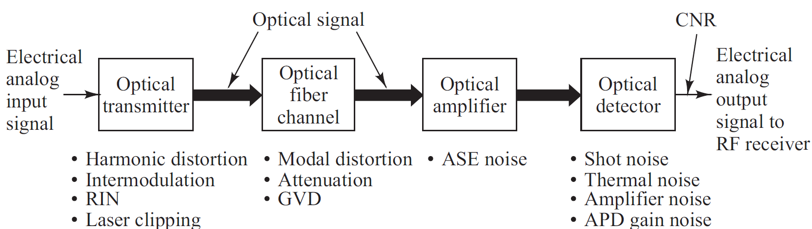
Analog Communication Links
Analog (RF) links are used where converting to digital signals is undesirable, including
• Analog TV and audio services
• Cable modem services
• Microwave-multiplexed signals (e.g., satellite base stations)
• Radar signal processing

Slide 34
Overview of Analog Links
A bias point on the source is set approximately at the midpoint of the linear output region. The analog signal can then be sent with direct intensity modulation technique.
Other modulation techniques include AM, FM and PM, which first convert baseband signal onto an electrical subcarrier prior to intensity modulation.
Signal impairments in optical source : harmonic distortions, inter-modulation (IM) products, RIN in the laser, and laser clipping.
The fiber should have a flat amplitude and group-delay response within the passband required to send the signal free of linear distortion.
Since modal-distortion-limited bandwidth is difficult to equalize, it is best to choose a single-mode fiber.

Slide 35
Radio Over Fiber (RoF) Link design and Performance Parameter

Slide 36
Radio Over Fiber (RoF)
Radio frequency (RF) signals at microwave and millimetre-wave frequencies are used in applications such as radars, satellite links, broadband terrestrial radios, and cable television networks.
The signal ranges include the
0.3- to 3-GHz ultra-high frequency (UHF) band,
3- to 30-GHz super-high frequency (SHF) region, and
30- to 300-GHz extremely high frequency (EHF) range.
Traditionally these RF systems used wireless or coaxial cable links for transporting the microwave signals from a receiving element (Ex. an antenna) to a signal processing centre, which could be located hundreds of meters away.
The methods for transmitting microwave analog signals over an optical fiber link have become known as RF-over-fiber techniques.

Slide 37
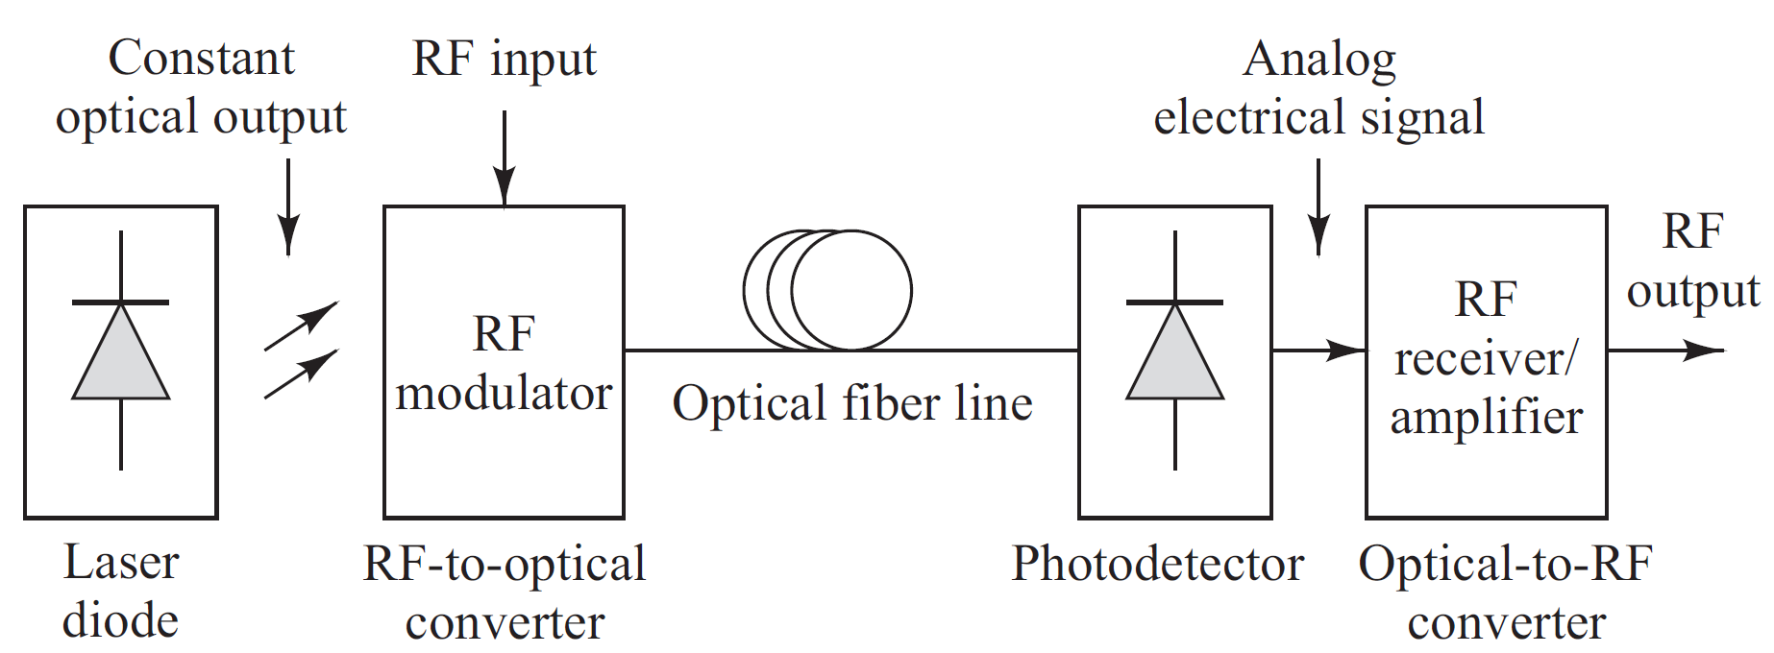
Generic RF–over-fiber Link
Fig: Basic constituents of a generic RF-over-fiber link
Three Major Modules:
An RF-to-optical signal converting device at the transmitting end,
An optical-to-RF signal converting device at the receiving end, and
An optical fiber that joins these two modules.

Slide 38
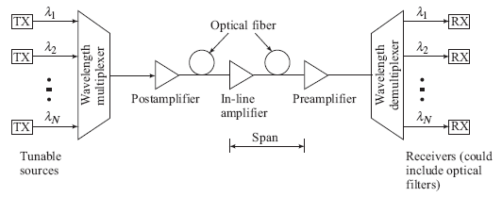
Overview of WDM
A characteristic of WDM is that the discrete wavelengths form an orthogonal set of carriers that can be separated, routed, and switched without interfering with each other.
WDM networks require a variety of passive and active devices to combine, distribute, isolate, and amplify optical power at different wavelengths.

Slide 39
Why WDM?
Capacity upgrade of existing fiber networks (without adding fibers)
Transparency: Each optical channel can carry any transmission format (different asynchronous bit rates, analog or digital)
Scalability– Buy and install equipment for additional demand as needed
Wavelength routing and switching: Wavelength is used as another dimension to time and space

Slide 40
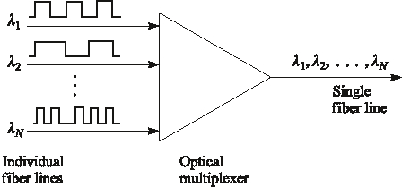
Wavelength Division Multiplexing
Each wavelength is like a channel (fiber)

Slide 41
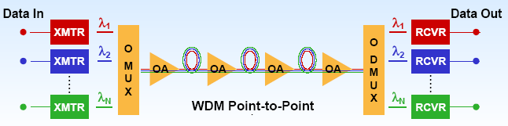
Wavelength Division Multiplexing
Passive/active devices are needed to combine, distribute, isolate and amplify optical power at different wavelengths

Slide 42
WDM, CWDM and DWDM
WDM technology uses multiple wavelengths to transmit information over a single fiber
Coarse WDM (CWDM) has wider channel spacing (20 nm) – low cost
Dense WDM (DWDM) has dense channel spacing (0.8 nm) which allows simultaneous transmission of 16+ wavelengths – high capacity

Slide 43
WDM and DWDM
First WDM networks used just two wavelengths, 1310 nm and 1550 nm
Today's DWDM systems utilize 16, 32,64,128 or more wavelengths in the 1550 nm window
Each of these wavelength provide an independent channel (Ex: each may transmit 10 Gb/s digital or SCMA analog)
The range of standardized channel grids includes 50, 100, 200 and 1000 GHz spacing
Wavelength spacing practically depends on:
laser linewidth
optical filter bandwidth

Slide 44
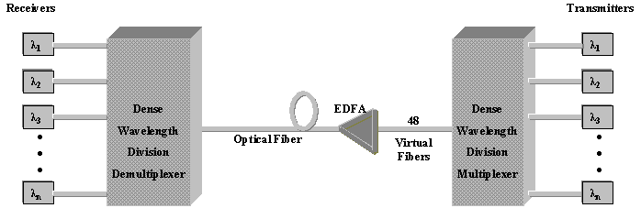
DWDM System
Block Diagram of DWDM System

Slide 45
DWDM Components
Transmitter : Laser with precise stable wavelength.
Link: Optical fiber that exhibits low loss and transmission performance in relevant wavelength spectra.
Receiver: Photo detectors and Optical demultiple-xers using thin film filters or diffractive elements.
Optical add/drop multiplexers and optical cross connect components.

Slide 46
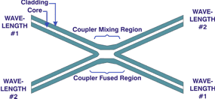
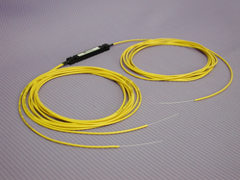
Optical Couplers
Optic couplers either split optical signals into multiple paths or combine multiple signals on one path.
The number of input (N)/ output (M) ports, (i.e. N x M size) characterizes a coupler.
Fused couplers can be made in any configuration, but they commonly use multiples of two (2 x 2, 4 x 4, 8 x 8, etc.).

Slide 47
Optical Couplers
Uses
Splitter: (50:50)
Taps: (90:10) or (95:05)
Combiners
An important issue:
two output differ π/2 in phase
Applications:
Optical Switches,
Mach Zehnder Interferometers,
Optical amplifiers,
passive star couplers, ...

Slide 48
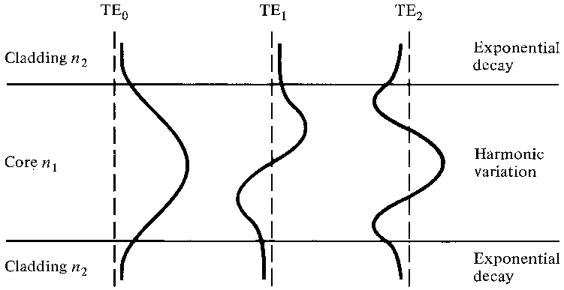
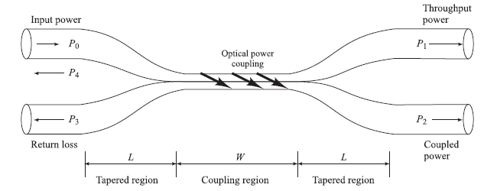
The 2 × 2 Fiber Coupler
P₀ is the input power, P₁ is the throughout power, and P₂ is the power coupled into the second fiber.
P₃ and P₄ are extremely low signal levels (-50 to -70 dB below the input level) resulting from backward reflections and scattering in the device
The evanescent tail from one fiber core couples into another closely spaced fiber core
Optical power
coupling

Slide 49
Performance Parameters
Coupling ratio or splitting ratio
In dB
For 2 x 2 coupler
Excess Loss

Slide 50
Performance Parameters
Insertion Loss
Isolation Loss or Crosstalk
In dB

Slide 51
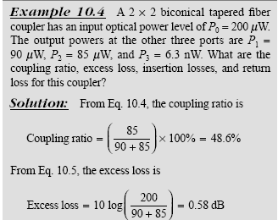
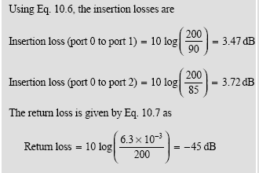
Example Coupler Performance

Slide 52
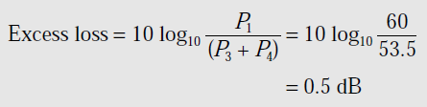


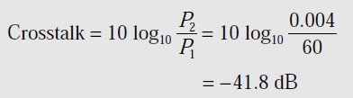
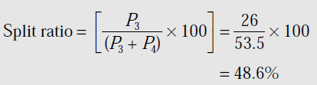
A four-port multimode fiber FBT coupler has 60 μW optical power launched into port 1. The measured output powers at ports 2, 3 and 4 are 0.004, 26.0 and 27.5 μW respectively. Determine the excess loss, the insertion losses between the input and output ports, the crosstalk and the split ratio for the device.
Solution:
The excess loss for the coupler
The Insertion Loss
Cross Talk
Split Ratio

Slide 53
Star Couplers
Optical couplers with more than four ports.
Types of star couplers:
transmission star coupler
the light at any of the input port is split equally through all output ports.
reflection star coupler

Slide 54
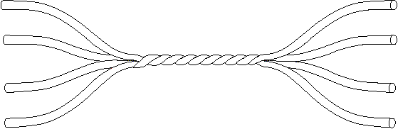
Fibre Star Coupler
Combines power from N inputs and divided them between M outputs
1
P₁
1
P_{N}
N
N
Coupling ratio
Excess loss
Power at any one output

Slide 55
Star Coupler - 8 X 8
Star couplers are optical couplers with more than four ports
λ₁
λ₁, λ₂, ... λ₈
λ₂
λ₃
λ₄
N/2
λ₅
λ₆
λ₇
λ₈
λ₁, λ₂, ... λ₈
No of 3 dB coupler

Slide 56
Star Coupler - 8 X 8 - contd.
If a fraction of power traversing each 3 dB coupler = F_{p},
where 0< F_{p} < 1.
Then, power lost within the coupler = 1- F_{p}.
Excess loss
Coupling ratio
(splitting loss)
Total loss = splitting loss + excess loss

Slide 57
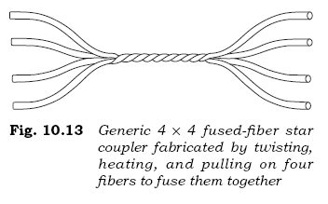
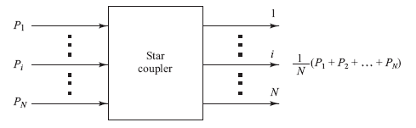


Star Couplers
In general, an N × M coupler has N inputs and M outputs

Slide 58
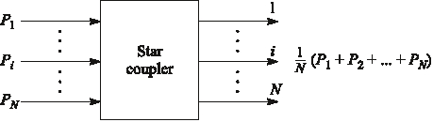
Basic Star Coupler
May have N inputs and M outputs
Can be wavelength selective/nonselective
Up to N =M = 64, typically N, M < 10

Slide 59
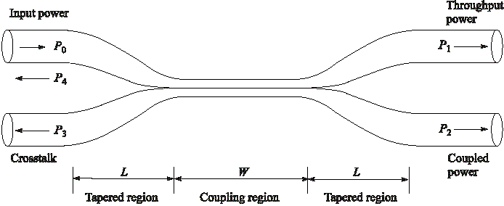
Fused-Biconical coupler OR Directional coupler
P3, P4 extremely low ( -70 dB below Po)
Coupling / Splitting Ratio = P2/(P1+P2)
If P₁=P₂ → It is called 3-dB coupler

Slide 60
Fused Biconical Tapered Coupler
Fabricated by twisting together, melting and pulling together two single mode fibers
They get fused together over length W; tapered section of length L; total draw length = L+W
Significant decrease in V-number in the coupling region; energy in the core leak out and gradually couples into the second fibre

Slide 61


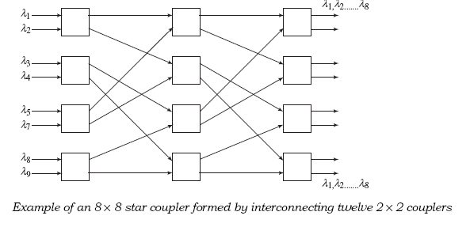
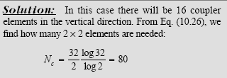
N × N Star Coupler
Can construct star couplers by cascading 3-dB couplers
The number of 3-dB couplers needed to construct an N × N star is

Slide 62
Coupler Characteristics
power ratio between both output can be changed by adjusting the draw length of a simple fused fiber coupler
It can be made a WDM de-multiplexer:
Example, 1300 nm will appear output 2 (p2) and 1550 nm will appear at output 1 (P1)
However, suitable only for few wavelengths that are far apart, not good for DWDM

Slide 63
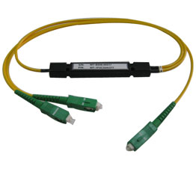
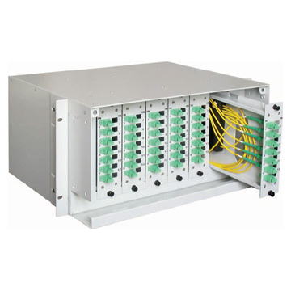
1x2 coupler
6x6 coupler

Slide 64
Splitters
The simplest couplers are fiber optic splitters.
They possess at least three ports but may have more than 32 for more complex devices.
Popular splitting ratios include 50%-50%, 90%-10%, 95%-5% and 99%-1%; however, almost any custom value can be achieved.
Excess loss: assures that the total output is never as high as the input. It hinders the performance. All couplers and splitters share this parameter.
They are symmetrical. For instance, if the same coupler injected 50 µW into the 10% output leg, only 5 µW would reach the common port.
Output
Output
Input

Slide 65

Coupler + Splitter - Applications
Local monitoring of a light source output (usually for control purposes).
Distributing a common signal to several locations simultaneously.
Making a linear, tapped fiber optic bus. Here, each splitter would be a 95%-5% device that allows a small portion of the energy to be tapped while the bulk of the energy continues down the main trunk.

Slide 66
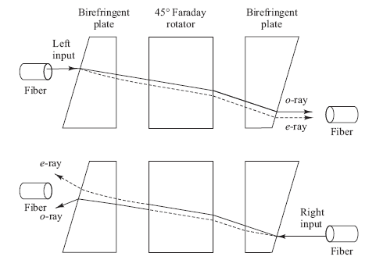
Optical Isolators
Optical isolators allow light to pass in only one direction.
This prevents scattered or reflected light from traveling in the reverse direction.
E.g., can keep backward-traveling light from entering a laser diode and possibly causing instabilities in the optical output.
Polarization-independent isolator made of three miniature optical components

Slide 67
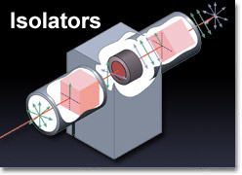
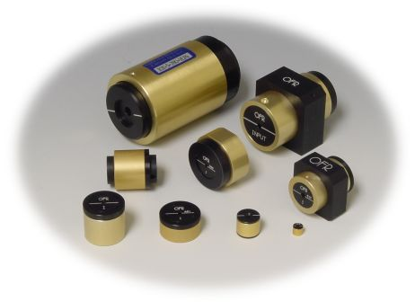
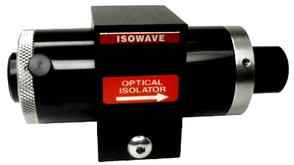
Isolators
5cm

Slide 68
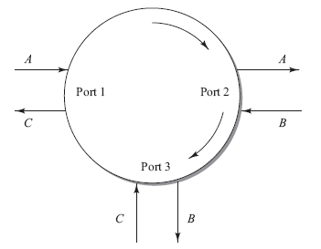
Optical Circulators
An optical circulator is a nonreciprocal multiport passive device that directs light sequentially from port to port in only one direction.
In the 3–port example, an input on port 1 is sent out on port 2, an input on port 2 is sent out on port 3, and an input on port 3 is sent out on port 1.

Slide 69
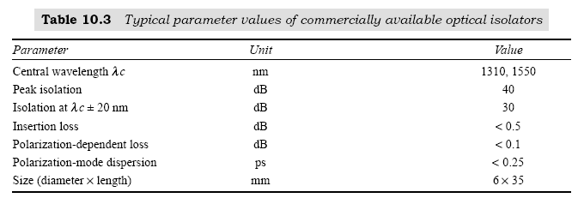
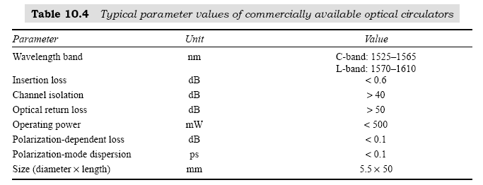
Isolator and Circulator Parameters

Slide 70
Mach-Zehnder Interferometer Multiplexers
Wavelength-dependent multiplexer/demultiplexer (WDM) can be made using Mach-Zehnder (MZ) interferometers.
2x2 MZ interferometer consists of 3 stages: 3-dB splitter, phase shift, 3-dB combiner.
Due to the phase shift between the two arms, the recombined signals will interference constructively at one output and destructively at the other :
Demultiplexer (Demux) : Ein,1 will separate at Eout,1, Eout,2
Multiplexer (Mux) : Both outputs Eout,1 and Eout,2 combine at Ein,1

Slide 71
Layout of a basic 2 x 2 Mach-Zehnder Interferometer

Slide 72

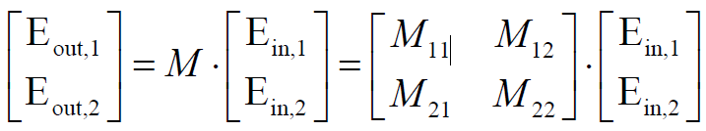
How to find output P1 and P2 by using matrix method ?
Write matrix for each stage:
- phase shift : MΔΦ- Wavelength dependent phase shift
- 3-dB splitting coupler : Mcoupler – Splits the input signal
- 3-dB combining coupler : Mcoupler - Recombines the signal at the output
Obtain the total matrix for MZ interferometer
Find output E-field Eout,1 and Eout,2 :
Find output power (or intensity) Pout,1 and Pout,2 :

Slide 73


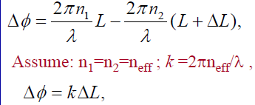

Details for matrix of each component :
3-dB splitting coupler : Mcoupler
Coupler matrix :
3-dB coupler matrix (no loss) :
Phase shift : MΔΦ
Assuming same sources for the two arms, phase shift due to the arm length
difference:
Matrix of the phase shift :

Slide 74
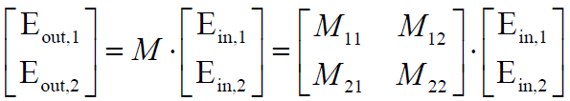
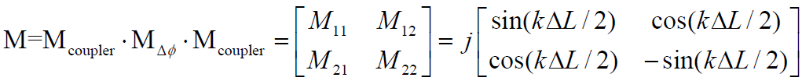
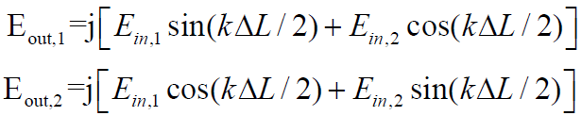
Total matrix : M
Find output E-field Eout,1 and Eout,2 :

Slide 75
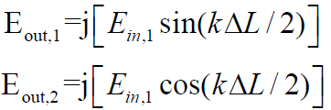


Assume that Ein,2 = 0,
Find output power (or intensity) Pout,1 and Pout,2 :
Spectrum or magnitude response of Pout,1 and Pout,2:

